Slide 1
Introduction to Cryptocurrencies
Week 2
Ofir Cohen
Based on Aviv Zohar’s lectures

Slide 2
P2PKH (Pay-to-Pub-Key-Hash)
ScriptPubKey = OP_DUP OP_HASH160 <Public KeyHash> OP_EQUAL OP_VERIFY OP_CHECKSIG
ScriptSig = <Signature> <Public Key>
First, we insert the ScriptSig
Notes:
Instead of pubkey we use “addresses” (shorter than pubkey)

Slide 3
P2PKH (Pay-to-Pub-Key-Hash)
ScriptPubKey = OP_DUP OP_HASH160 <Public KeyHash> OP_EQUAL OP_VERIFY OP_CHECKSIG
ScriptSig = <Signature> <Public Key>
Signature
Notes:
Instead of pubkey we use “addresses” (shorter than pubkey)

Slide 4
P2PKH (Pay-to-Pub-Key-Hash)
ScriptPubKey = OP_DUP OP_HASH160 <Public KeyHash> OP_EQUAL OP_VERIFY OP_CHECKSIG
ScriptSig = <Signature> <Public Key>
PK
Signature
Notes:
Instead of pubkey we use “addresses” (shorter than pubkey)

Slide 5
P2PKH (Pay-to-Pub-Key-Hash)
ScriptPubKey = OP_DUP OP_HASH160 <Public KeyHash> OP_EQUAL OP_VERIFY OP_CHECKSIG
ScriptSig = <Signature> <Public Key>
PK
PK
Signature
Notes:
Instead of pubkey we use “addresses” (shorter than pubkey)

Slide 6
P2PKH (Pay-to-Pub-Key-Hash)
ScriptPubKey = OP_DUP OP_HASH160 <Public KeyHash> OP_EQUAL OP_VERIFY OP_CHECKSIG
ScriptSig = <Signature> <Public Key>
H(PK)
PK
Signature
Notes:
Instead of pubkey we use “addresses” (shorter than pubkey)

Slide 7
P2PKH (Pay-to-Pub-Key-Hash)
ScriptPubKey = OP_DUP OP_HASH160 <Public KeyHash> OP_EQUAL OP_VERIFY OP_CHECKSIG
ScriptSig = <Signature> <Public Key>
H(PK)
Public KeyHash
PK
Signature
Notes:
Instead of pubkey we use “addresses” (shorter than pubkey)

Slide 8
P2PKH (Pay-to-Pub-Key-Hash)
ScriptPubKey = OP_DUP OP_HASH160 <Public KeyHash> OP_EQUAL OP_VERIFY OP_CHECKSIG
ScriptSig = <Signature> <Public Key>
H(PK)
Public KeyHash
PK
Signature
Notes:
Instead of pubkey we use “addresses” (shorter than pubkey)

Slide 9
P2PKH (Pay-to-Pub-Key-Hash)
ScriptPubKey = OP_DUP OP_HASH160 <Public KeyHash> OP_EQUAL OP_VERIFY OP_CHECKSIG
ScriptSig = <Signature> <Public Key>
PK
Signature
Notes:
Instead of pubkey we use “addresses” (shorter than pubkey)

Slide 10
Today
Hash Functions
Usage of hash functions
What is Bitcoin’s cryptographic riddle?

Slide 11
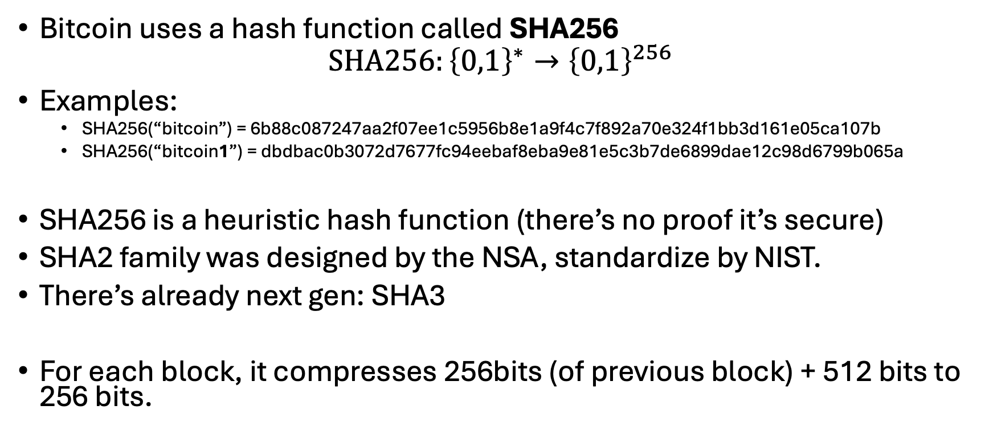
Cryptographic Hash Functions
Bitcoin uses a hash function called SHA256
$$SHA256:{\left\{0,1\right\}}^{∗}→{\left\{0,1\right\}}^{256}$$
Examples:
SHA256(“bitcoin”) = 6b88c087247aa2f07ee1c5956b8e1a9f4c7f892a70e324f1bb3d161e05ca107b
SHA256(“bitcoin1”) = dbdbac0b3072d7677fc94eebaf8eba9e81e5c3b7de6899dae12c98d6799b065a
SHA256 is a heuristic hash function (there’s no proof it’s secure)
SHA2 family was designed by the NSA, standardize by NIST.
There’s already next gen: SHA3
For each block, it compresses 256bits (of previous block) + 512 bits to 256 bits.

Slide 12
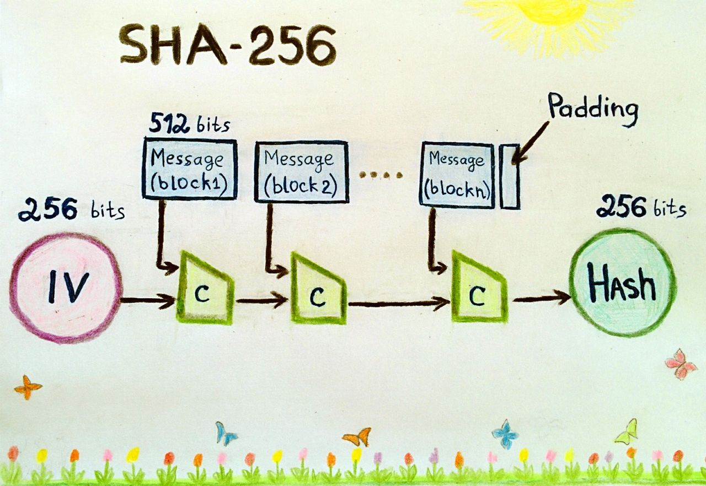
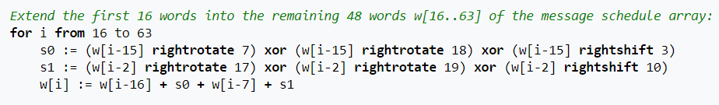
A word is 32bits
The original 512bit block yields 16 words,
but is extended to 64 words.
From the Bitcoin wiki

Slide 13
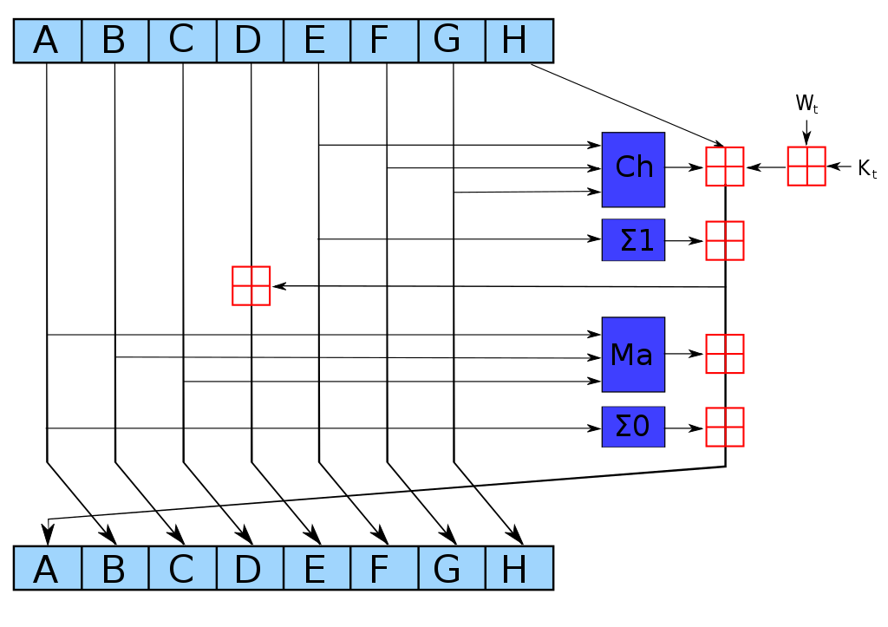
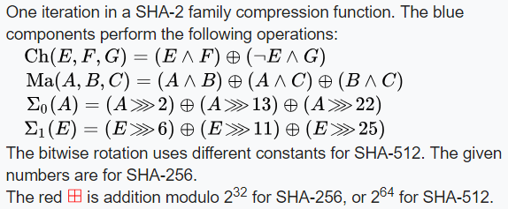
Old hash value (from prev round / block)
The 64 Words enter here, one at a time
A single round (SHA256 uses 64 iterations)
Illustration: From wikipedia

Slide 14
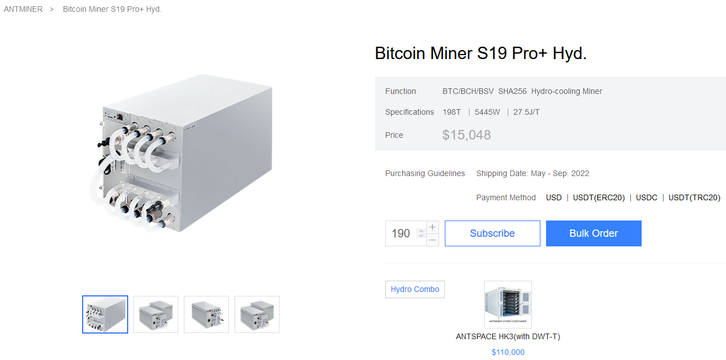

Slide 15
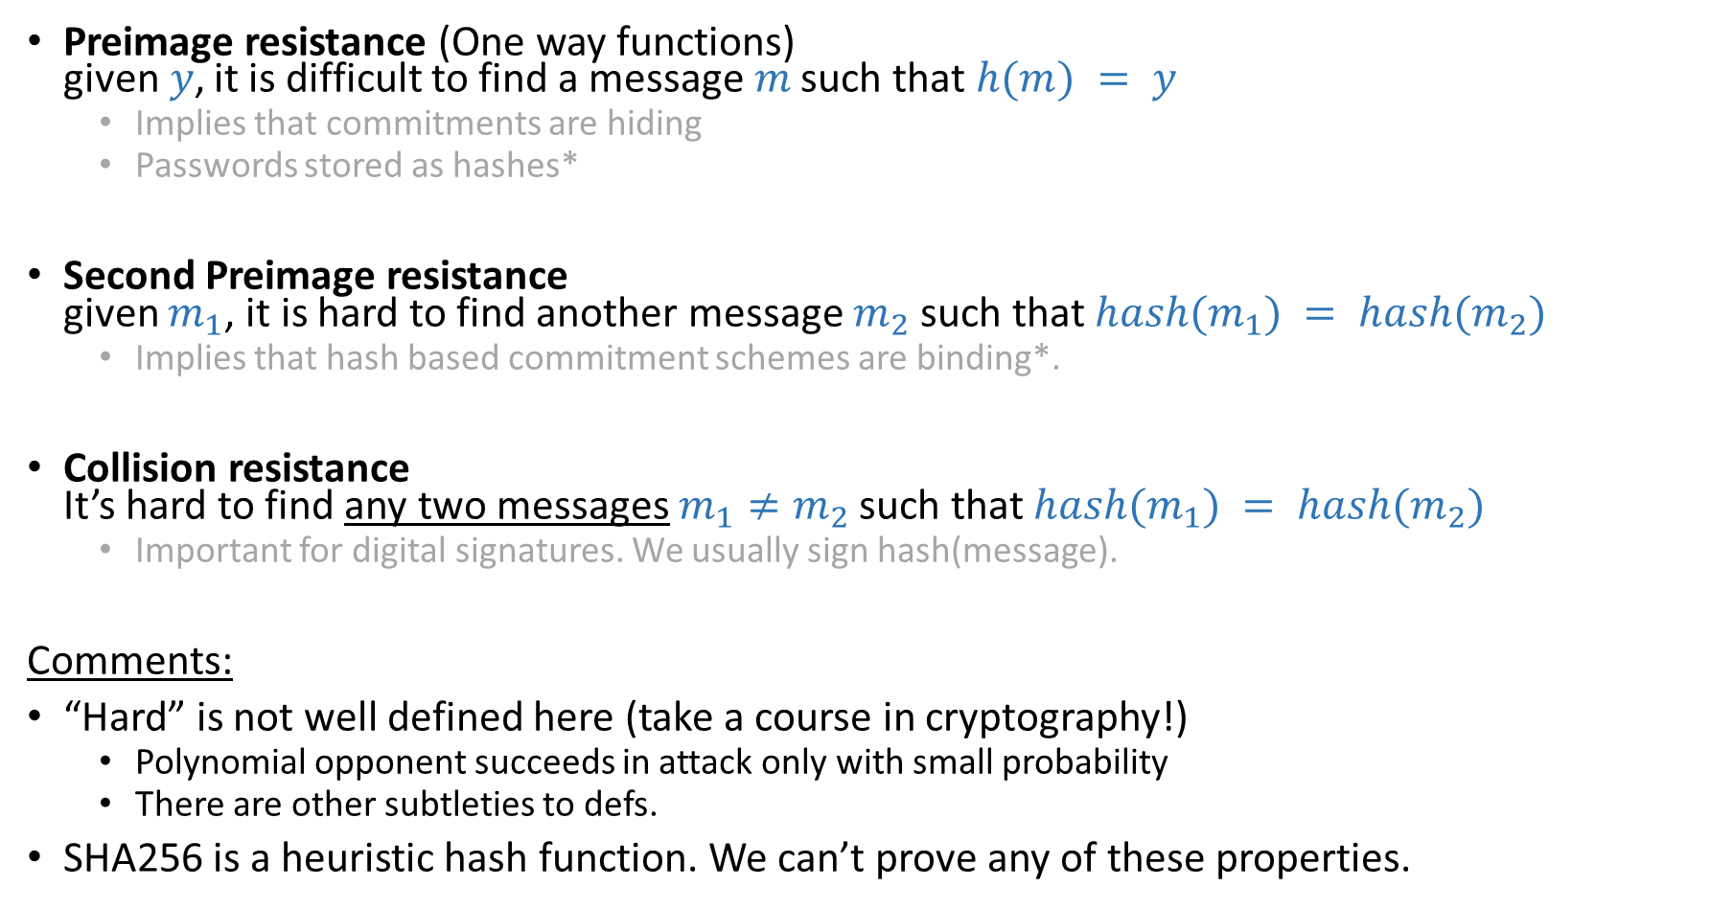
Properties of cryptographic hash functions
Preimage resistance (One way functions) given$y$, it is difficult to find a message$m$ such that $h(m) = y$
Implies that commitments are hiding
Passwords stored as hashes*
Second Preimage resistance given $m_{1}$, it is hard to find another message $m_{2}$ such that $hash(m_{1}) = hash(m_{2})$
Implies that hash based commitment schemes are binding*.
Collision resistance It’s hard to find any two messages $m_{1}≠m_{2}$ such that $hash(m_{1}) = hash(m_{2})$
Important for digital signatures. We usually sign hash(message).
Comments:
“Hard” is not well defined here (take a course in cryptography!)
Polynomial opponent succeeds in attack only with small probability
There are other subtleties to defs.
SHA256 is a heuristic hash function. We can’t prove any of these properties.
Notes:
Hiding meaning is that it is hard to know the message
Biding meaning is that it is computationally hard to find a collision with another value

Slide 16
The Random Oracle Model
We can think of our hash function as an oracle that answers queries.
The oracle has immense powers.
It maps input to a uniformly random output.
If the function is ever called again, it’ll yield the exact same output.
Can be thought as a huge table, filled randomly and then used for the outputs:

Slide 17
The Random Oracle Model
Input | Output
0 | 5FECEB66FFC86F38D952786C6D696C79C2DBC239DD4E91B46729D73A27FB57E9
1 | 6B86B273FF34FCE19D6B804EFF5A3F5747ADA4EAA22F1D49C01E52DDB7875B4B
00 | D4735E3A265E16EEE03F59718B9B5D03019C07D8B6C51F90DA3A666EEC13AB35
01 | 4E07408562BEDB8B60CE05C1DECFE3AD16B72230967DE01F640B7E4729B49FCE
100 | 4B227777D4DD1FC61C6F884F48641D02B4D121D3FD328CB08B5531FCACDABF8A
…

Slide 18
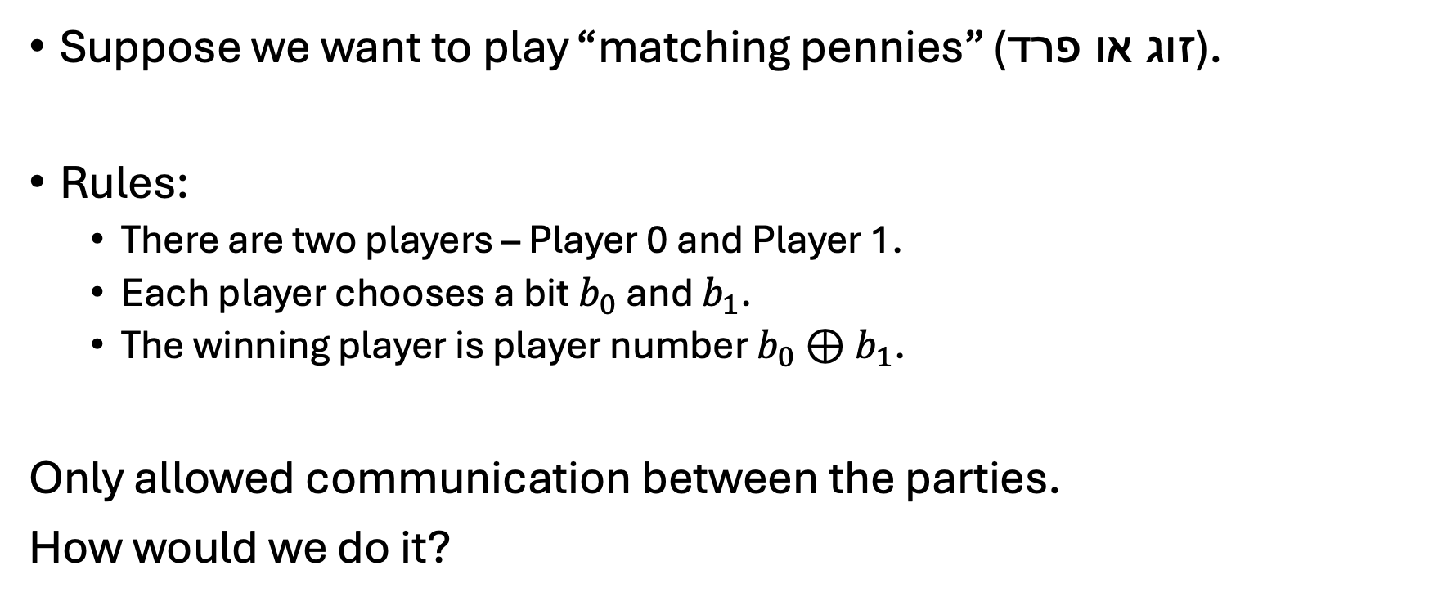
Example: Matching Pennies
Suppose we want to play “matching pennies” (זוג או פרד).
Rules:
There are two players – Player 0 and Player 1.
Each player chooses a bit $b_{0}$ and $b_{1}$.
The winning player is player number $b_{0}⊕b_{1}$.
Only allowed communication between the parties.
How would we do it?

Slide 19
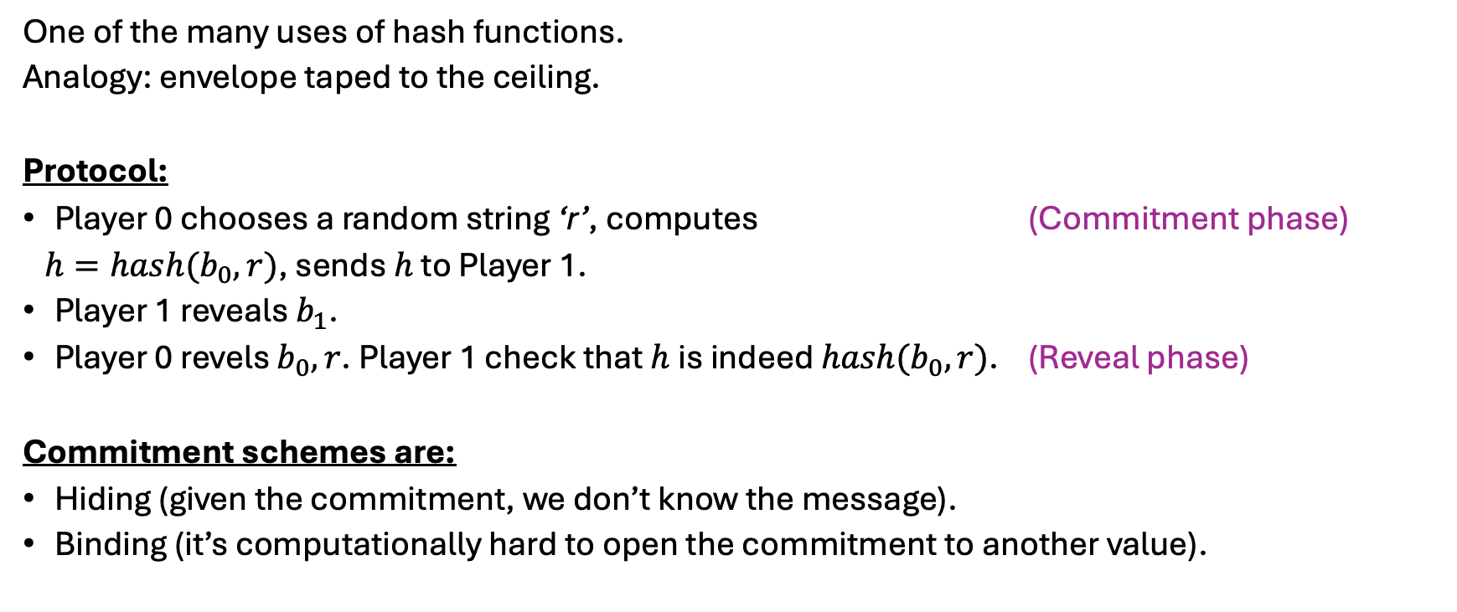
Commitment schemes from hash functions
One of the many uses of hash functions.
Analogy: envelope taped to the ceiling.
Protocol:
Player 0 chooses a random string ‘r’, computes (Commitment phase)
$h=hash(b_{0},r)$, sends $h$ to Player 1.
Player 1 reveals $b_{1}$.
Player 0 revels $b_{0},r$. Player 1 check that $h$ is indeed $hash(b_{0},r)$. (Reveal phase)
Commitment schemes are:
Hiding (given the commitment, we don’t know the message).
Binding (it’s computationally hard to open the commitment to another value).

Slide 20
Merkle trees
CRH
CRH
CRH
CRH
CRH
CRH
CRH
CRH
CRH
CRH
CRH
CRH
CRH
CRH
CRH
Notes:
מבנה נתונים יעיל שעזרתו אפשר לוודא את האמינות של טרנזקציה כלשהי שבאמת מופיעה בבלוק.
כל עלה בעץ הוא טרנזקציה, וכל צומת בעץ הוא hash על הילדים של אותו צומת.

Slide 21
The root acts as a representative of the set of records (an Accumulator)
We can quickly prove X is in the set by showing a path to x.
Cheating requires finding a hash collision
CRH
CRH
CRH
CRH
CRH
CRH
CRH
CRH
CRH
CRH
CRH
CRH
CRH
CRH
CRH
x

Slide 22
Bitcoins PoW (Proof of Work)

Slide 23
Questions we need to answer
PoW - why is it hard to create blocks?
Blockchain
Is the chain “well formed”? Do all blocks have different hashes?
Why can’t we start working early on a problem and save solutions for later?
Can someone swap a block in the blockchain and fool a newcomer?

Slide 24
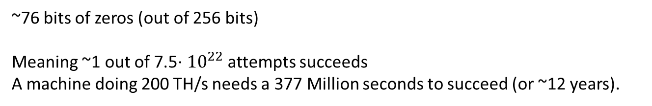
Bitcoin’s proof of work
Hash
Nonce
The requirement: hash(block)<Target
Really only an 80 Byte header is hashed. We’ll get to that.
If hash doesn’t match, change the Nonce and try again.
Also possible to change something else (new txs, timestamp, etc)
Hash
00001001011011001
A small number
Target = 0000000000000000000a37730000000000000000000000000000000000000000
~76 bits of zeros (out of 256 bits)
Meaning ~1 out of 7.5$⋅{10}^{22}$ attempts succeeds
A machine doing 200 TH/s needs a 377 Million seconds to succeed (or ~12 years).

Slide 25
Bitcoin’s block header
Really only the header is hashed.
Field | Description
Version | The version of the block.
Previous Block Hash | The Block Hash of the block that this block is being built on top of. This is what “chains” the blocks together.
Merkle Root | All the transactions in this block, hashed together. Basically, provides a single-line summary of all transactions in this block.
Time | When a miner is trying to mine this block, the Unix time at which this block header is being hashed is noted within the block header itself.
Bits | A shortened version of the Target.
Nonce | The field that miners change in order to try and get a hash of the block header (a Block Hash) that is below the Target.

Slide 26
Implication to the structure of the blockchain
Can we have a cycle in the blockchain?
Can there be two blocks with the same hash?
Can I build the block at height h before I know the block a height h-1?

Slide 27
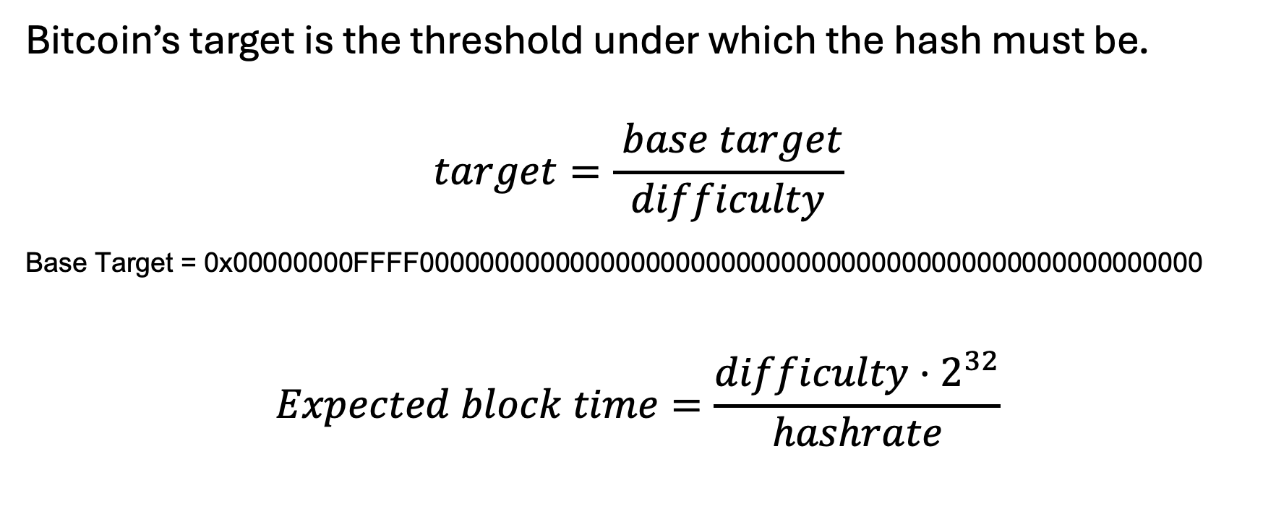
Bitcoin’s difficulty and difficulty adjustments
Bitcoin’s target is the threshold under which the hash must be.
$$target=\frac{ base target}{difficulty}$$
Base Target = 0x00000000FFFF0000000000000000000000000000000000000000000000000000
$$Expected block time=\frac{difficulty⋅2^{32}}{hashrate}$$

Slide 28
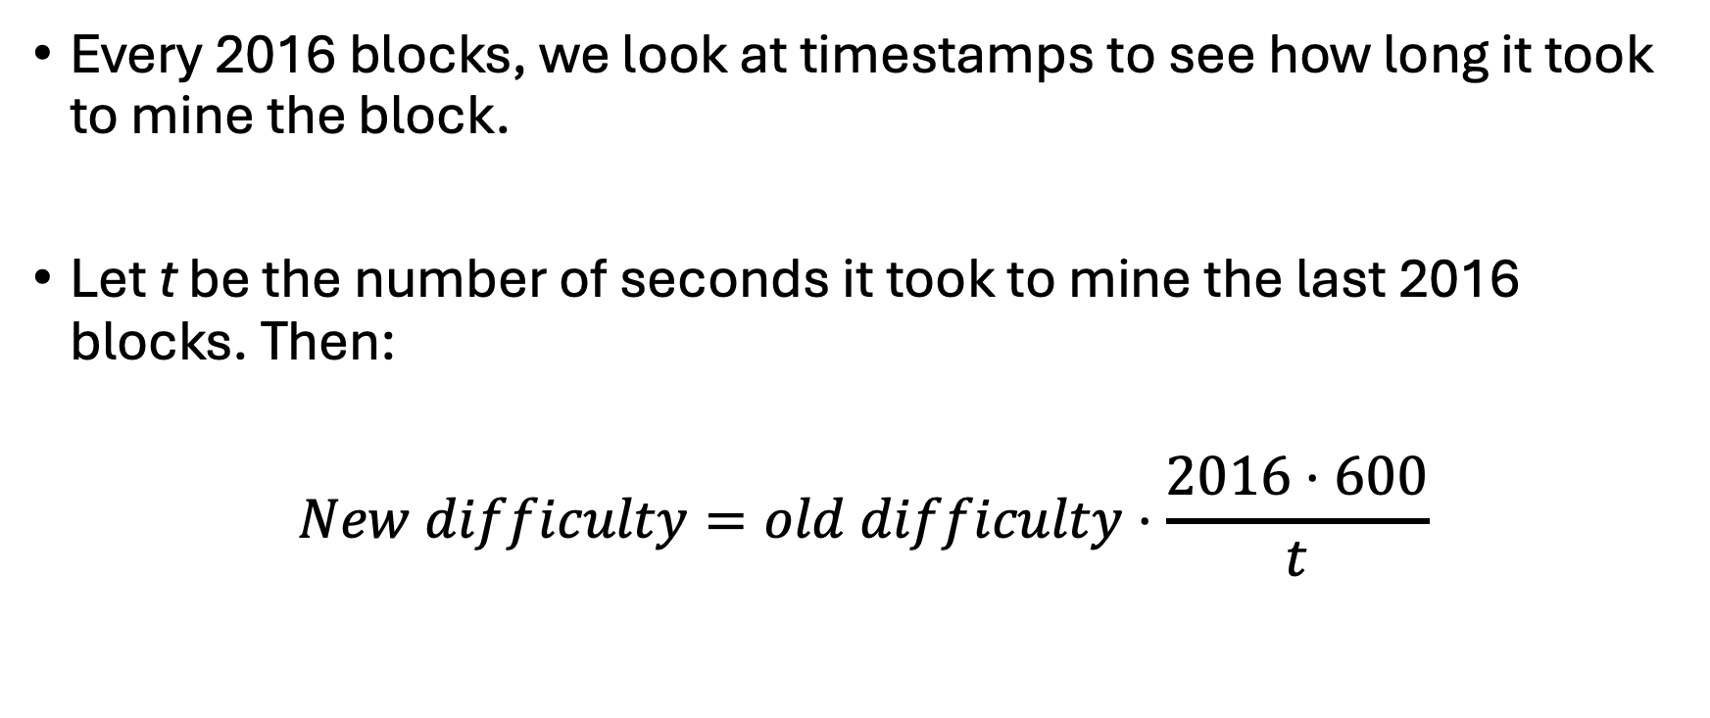
Difficulty Adjustments
Every 2016 blocks, we look at timestamps to see how long it took to mine the block.
Let t be the number of seconds it took to mine the last 2016 blocks. Then:
$$New difficulty=old difficulty⋅\frac{2016⋅600}{t}$$

Slide 29
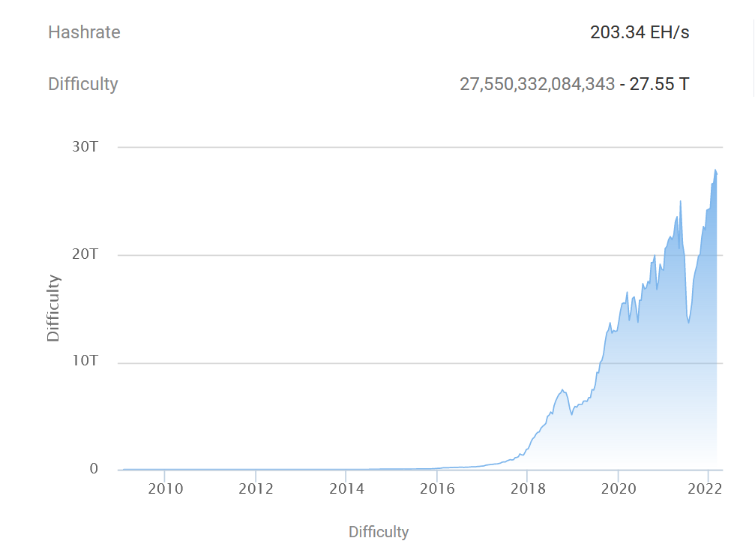


Bitcoin’s difficulty and difficulty adjustments
From btc.com

Slide 30
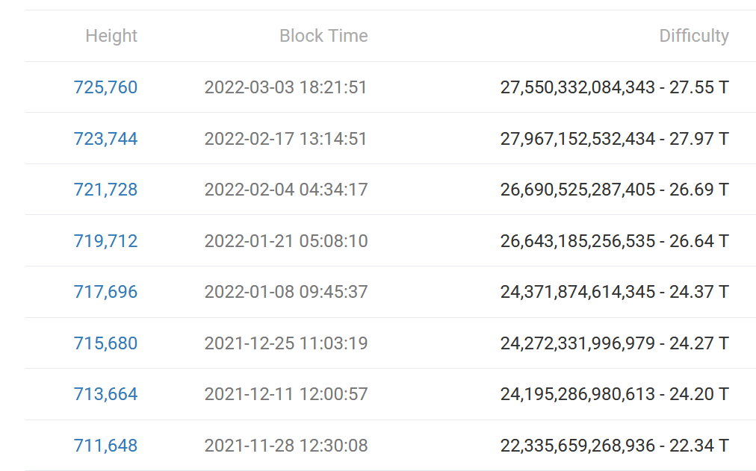
Bitcoin’s difficulty and difficulty adjustments
The current Target (Block 726968) in Hex:
0000000000000000000a37730000000000000000000000000000000000000000

